Slide 1

CS302 Design and Analysis of Algorithms
Muhammad sohail afzal

Slide 2
Graphs – Minimum spanning tree (MST)
A minimum spanning tree (MST) or minimum weight spanning tree is a subset of the edges of a connected, edge-weighted undirected graph that connects all the vertices together, without any cycles and with the minimum possible total edge weight/costs.

Slide 3
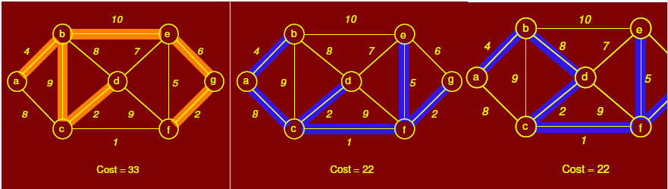
Graphs – Minimum spanning tree (MST)
Below figure shows three spanning trees for same graph. First is a spanning tree but not MST while other two are MST.

Slide 4
Graphs – Minimum spanning tree (MST)
There are two greedy algorithms (greedy in a sense that both chooses the best edge i-e having minimum cost) for finding minimum spanning tree
1) kruskal algorithm (time complexity = theta(ElogV) )
2) Prims Algorithm (time complexity = theta(ElogV) )
Where E is set of edges and V is set of vertices
Applications of Minimum Spanning Tree :
Laying cables
Laying pipes network or phone network
Tour Operations and many more

Slide 5
Graphs – Kruskal Algorithm for MST
Kruskal algorithm Steps for finding MST :
First select minimum cost edge.
Now select next minimum edge such that it does not form a cycle after addition and repeat this process.
At the end, you will get minimum spanning tree. Sum the cost of all edges and that will be the minimum spanning tree cost.

Slide 6
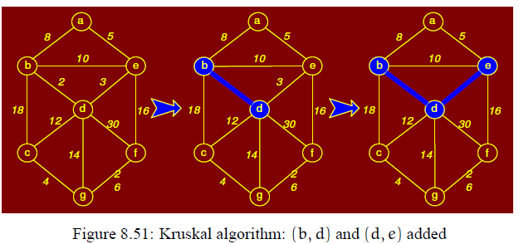
Graphs – Kruskal example

Slide 7
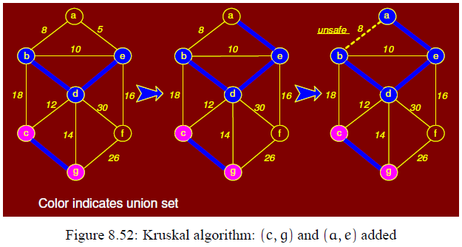
Graphs – Kruskal example

Slide 8
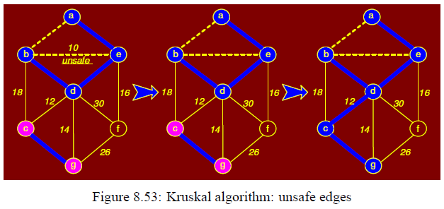
Graphs – Kruskal example

Slide 9
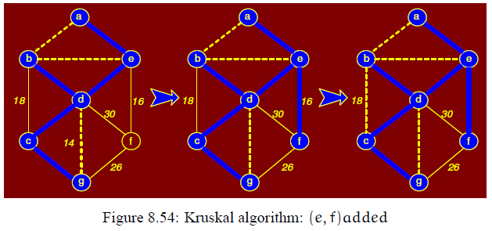
Graphs – Kruskal example

Slide 10
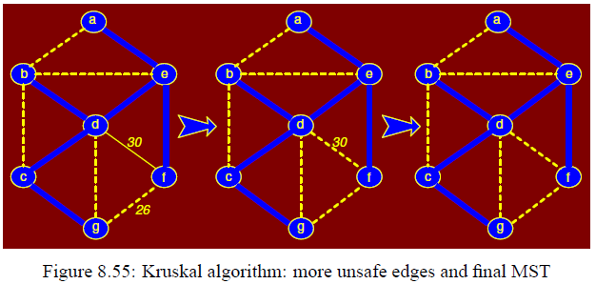
Graphs – Kruskal example
Graph at the end (most right side) is minimum spanning tree.

Slide 11
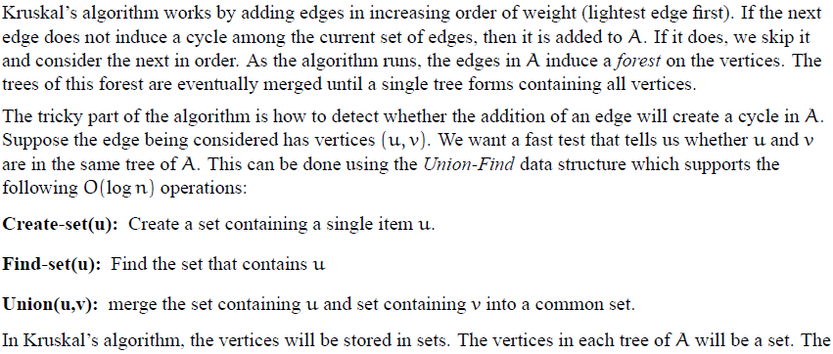
Graphs – Internal Working of Kruskal

Slide 12
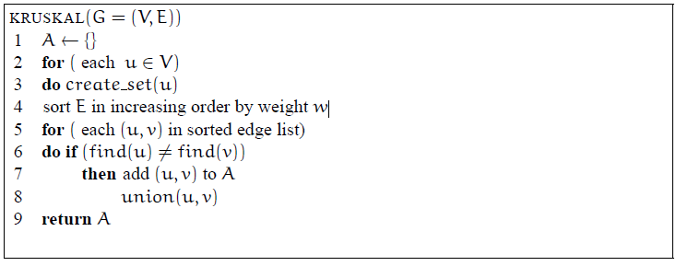
Graphs – Internal Working of Kruskal
Or you can write theta(ElogE) to theta(ElogV) as number of nodes and vertices are almost equal

